Slide 1

STOCK PRICE PREDICTION
by

Slide 2
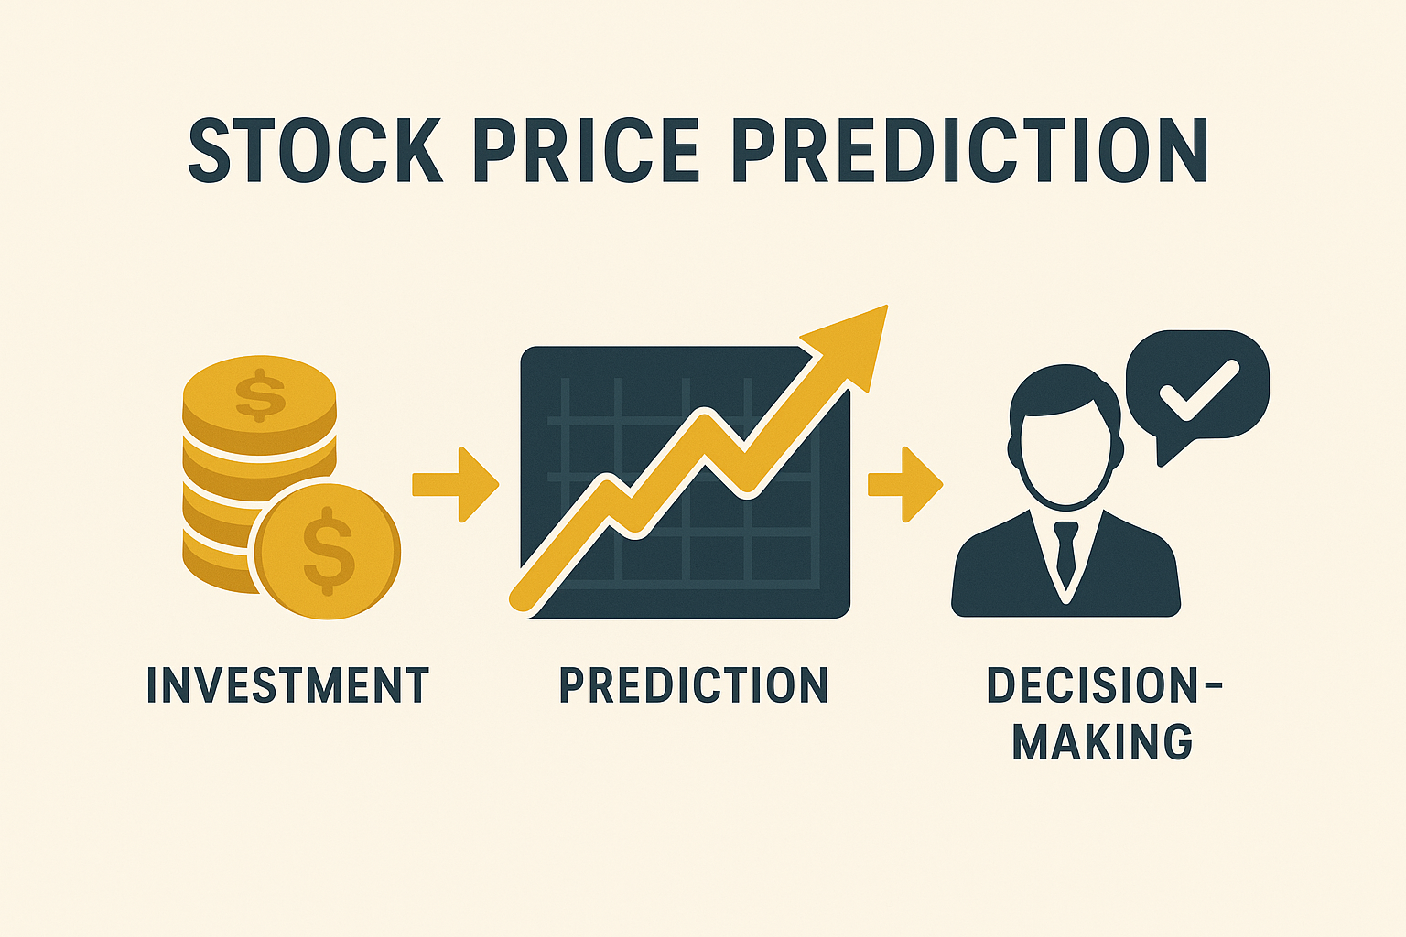
Introduction
Stock markets reflect economic activity and investor sentiment.
Prices are influenced by supply-demand, global events, and company performance.
Prediction helps in:
Investment planning
Risk management
Better decision-making
Aim: Build a machine learning model to predict stock prices from historical data.

Slide 3
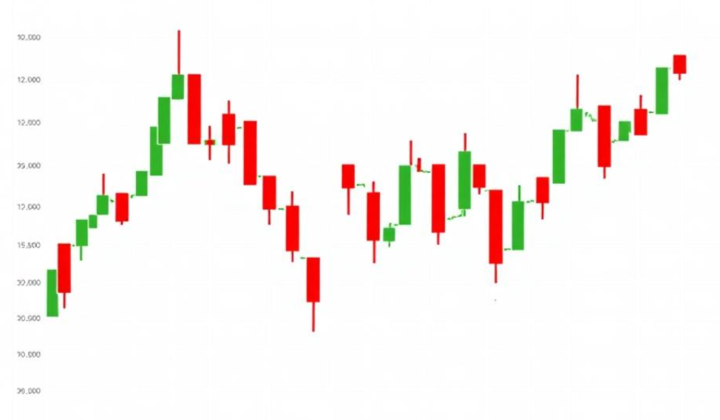
Problem Statement
Stock price prediction is difficult due to:
High volatility and uncertainty
Non-linear and time-dependent patterns
Influence of external factors (news, economy, politics)
Traditional approaches (like moving averages, ARIMA) are limited.
Machine Learning and Deep Learning offer better ways to capture patterns.

Slide 4
Methodology
Data Collection: Historical stock data (Yahoo Finance / Kaggle).
Features: Open, High, Low, Close, Volume, Moving Averages.
Preprocessing:
Handle missing values
Normalize/scale data
Train-test split (e.g., 80:20)
Model Selection:
Regression (Linear/Polynomial) for baseline
LSTM (Long Short-Term Memory) for time-series prediction
Comparison between models

Slide 5
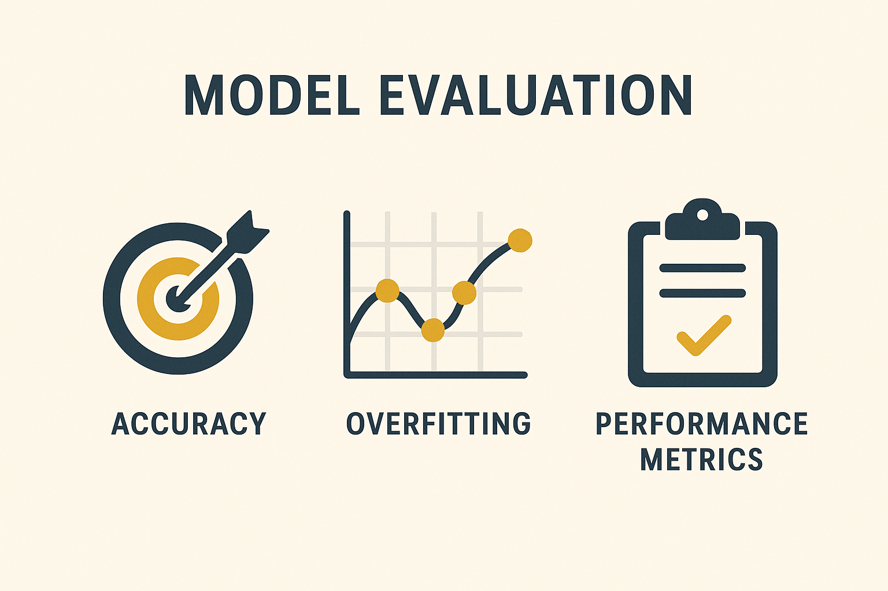
Implementation
Workflow:
Data Collection
Preprocessing & Feature Engineering
Model Training (LSTM/Regression)
Prediction & Evaluation
Tools Used: Python, Pandas, Numpy, Scikit-learn, TensorFlow, Matplotlib.
Example: Train LSTM with past 60 days’ prices → predict next day’s closing price.
Code Snippet (short): Data input → Model → Output prediction.

Slide 6
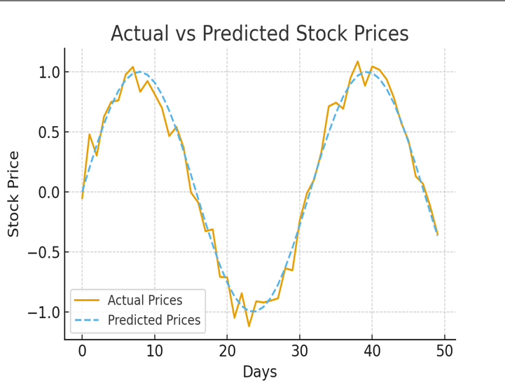
Result & Analysis
Evaluation Metrics:
RMSE (Root Mean Square Error)
MAE (Mean Absolute Error)
R² Score
Findings:
LSTM outperformed simple regression in accuracy.
Predicted prices closely followed actual trends.
Visual: Line chart of Actual vs Predicted stock prices.
Insight: Model captures general trend but struggles with sudden market shocks.

Slide 7
Conclusion & Future Scope
Conclusion:
Machine Learning models can effectively forecast stock price movements.
LSTM shows strong performance for sequential time-series data.
Future Enhancements:
Include sentiment analysis (news, tweets, market reports).
Hybrid models (ARIMA + LSTM, or ML + Technical Indicators).
Deploy as a web dashboard for real-time prediction.

Slide 8
THANK YOU

